Slide 1





Introduction To Python Programming

Slide 2

Hello!
I am Eslam Ahmed
I am a software engineer.
You can find me at jeksogsa@gmail.com

Slide 3
Introduction to Python programming Course Outline
Intro to Computer Science
Environment Setup (Anaconda)
Command Line
Conda & pip package managers
Jupyter Notebook
Input & Output
Variables
Data types
Numbers & Math
Boolean & Comparison and Logic
Strings
Lists
Tuples
Sets
Dictionaries
File Handling
If Conditions
For Loops
Built-in functions & Operators (zip, enumerate, range, …)
List Comprehensions
Functions
Lambda Expressions
Map, Filter, Reduce
Variables Scope
Modules & Packages

Slide 4
Introduction to Python programming Course Outline
Intro to Computer Science
Environment Setup (Anaconda)
Command Line
Conda & pip package managers
Jupyter Notebook
Input & Output
Variables
Data types
Numbers & Math
Boolean & Comparison and Logic
Strings
Lists
Tuples
Sets
Dictionaries
File Handling
If Conditions
For Loops
Built-in functions & Operators (zip, enumerate, range, …)
List Comprehensions
Functions
Lambda Expressions
Map, Filter, Reduce
Variables Scope
Modules & Packages

Slide 5
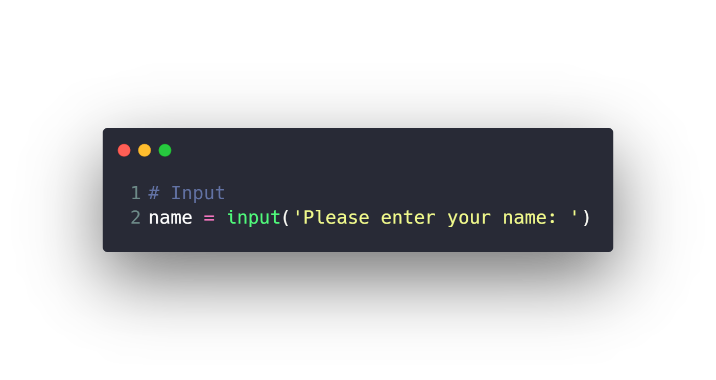


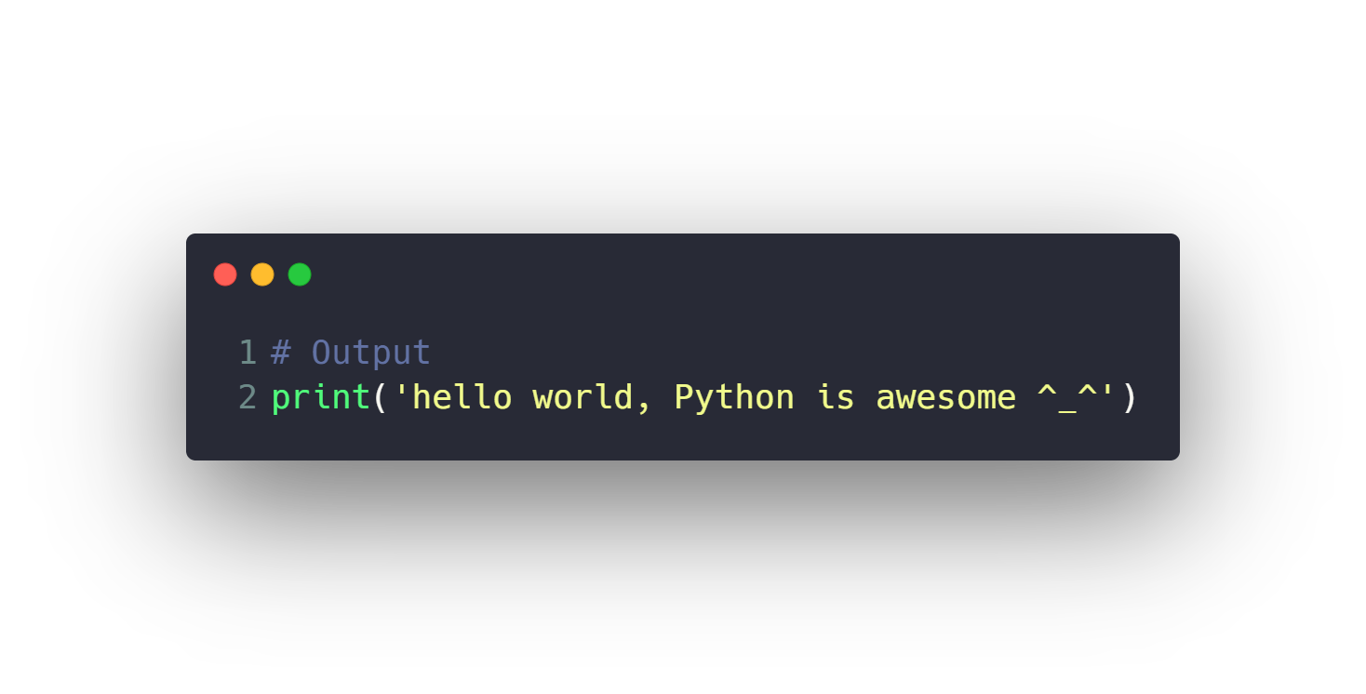

Input & Output

Slide 6
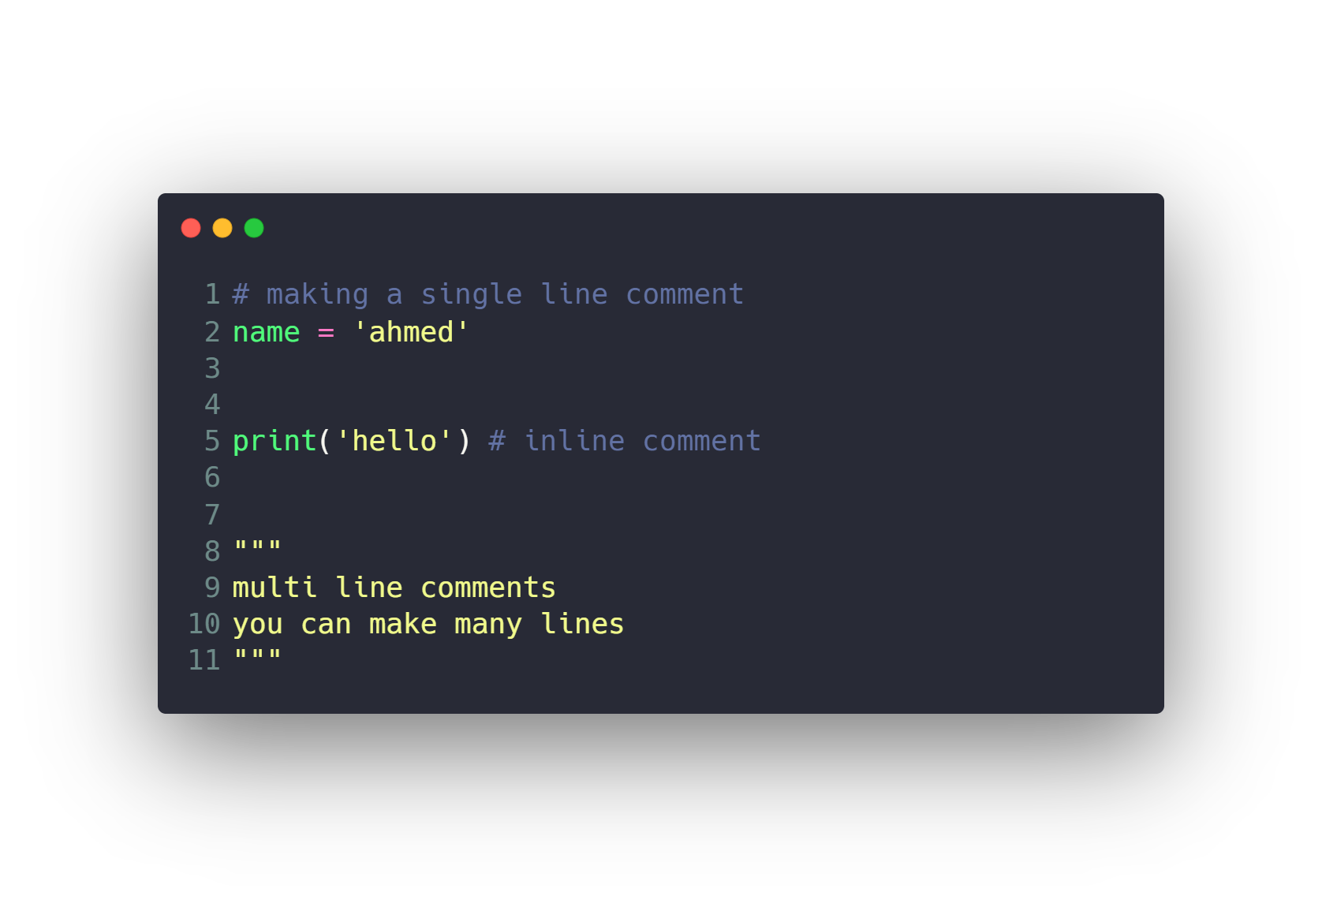
Input & Output
Comments

Slide 7
Introduction to Python programming Course Outline
Intro to Computer Science
Environment Setup (Anaconda)
Command Line
Conda & pip package managers
Jupyter Notebook
Input & Output
Variables
Data types
Numbers & Math
Boolean & Comparison and Logic
Strings
Lists
Tuples
Sets
Dictionaries
File Handling
If Conditions
For Loops
Built-in functions & Operators (zip, enumerate, range, …)
List Comprehensions
Functions
Lambda Expressions
Map, Filter, Reduce
Variables Scope
Modules & Packages

Slide 8
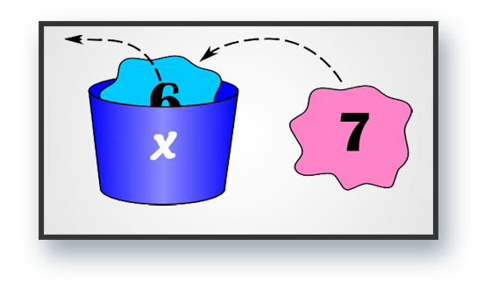
Variables

Slide 9
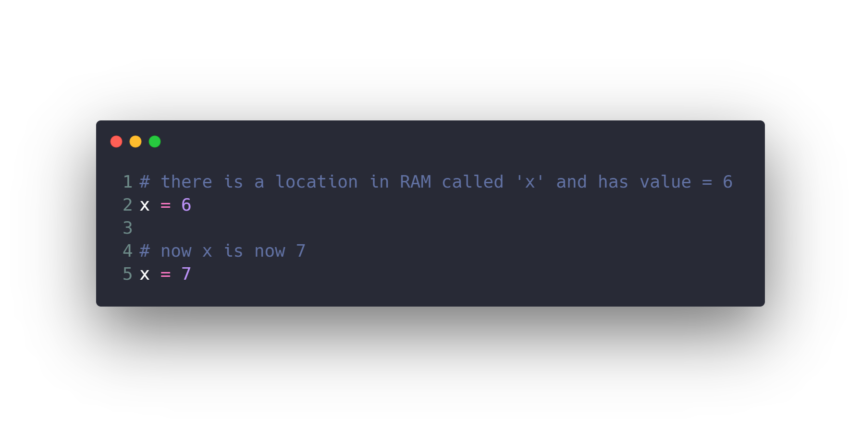
Variables

Slide 10
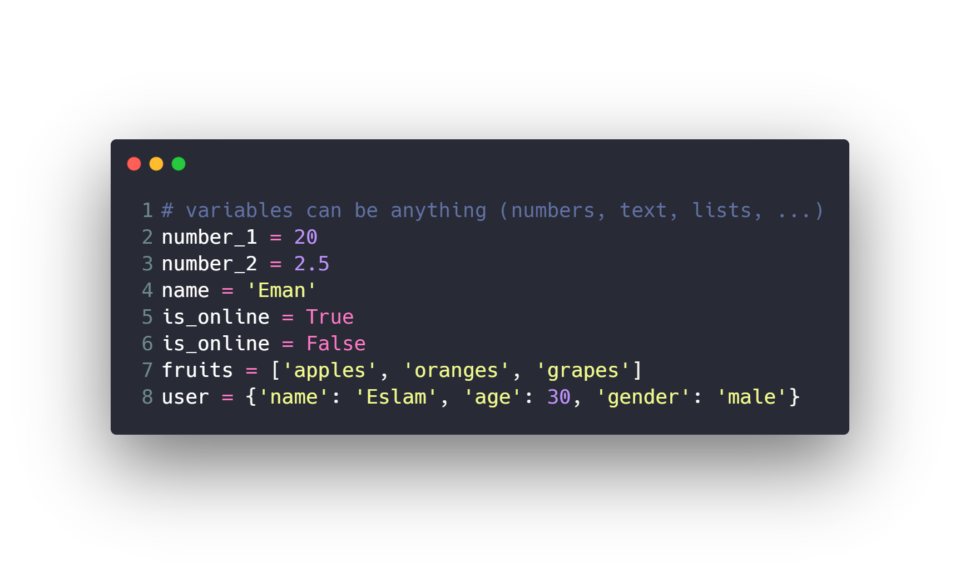
Variables

Slide 11
Variables
Rules for variables assignment
Names cannot start with numbers.
There can be no spaces, use _ instead.
Can’t use these symbols :”’<>/?|\()!@#$%^&*~-+=[],.
Avoid using words that have special meaning in Python like list.
For best practice user lowercase letters.
Use easy and meaningful name and related to the problem.

Slide 12
Introduction to Python programming Course Outline
Intro to Computer Science
Environment Setup (Anaconda)
Command Line
Conda & pip package managers
Jupyter Notebook
Input & Output
Variables
Data types
Numbers & Math
Boolean & Comparison and Logic
Strings
Lists
Tuples
Sets
Dictionaries
File Handling
If Conditions
For Loops
Built-in functions & Operators (zip, enumerate, range, …)
List Comprehensions
Functions
Lambda Expressions
Map, Filter, Reduce
Variables Scope
Modules & Packages

Slide 13
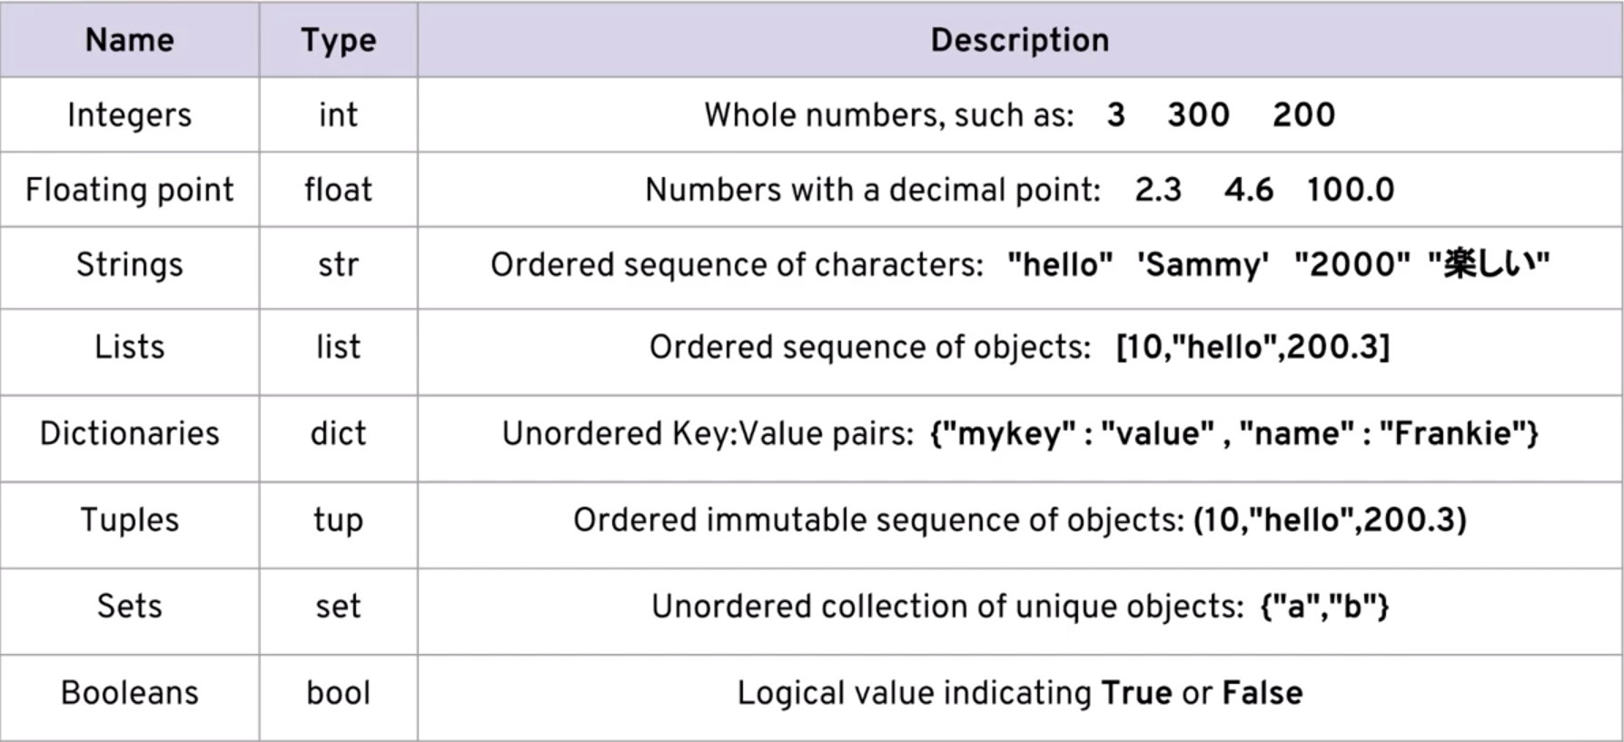
Data types

Slide 14
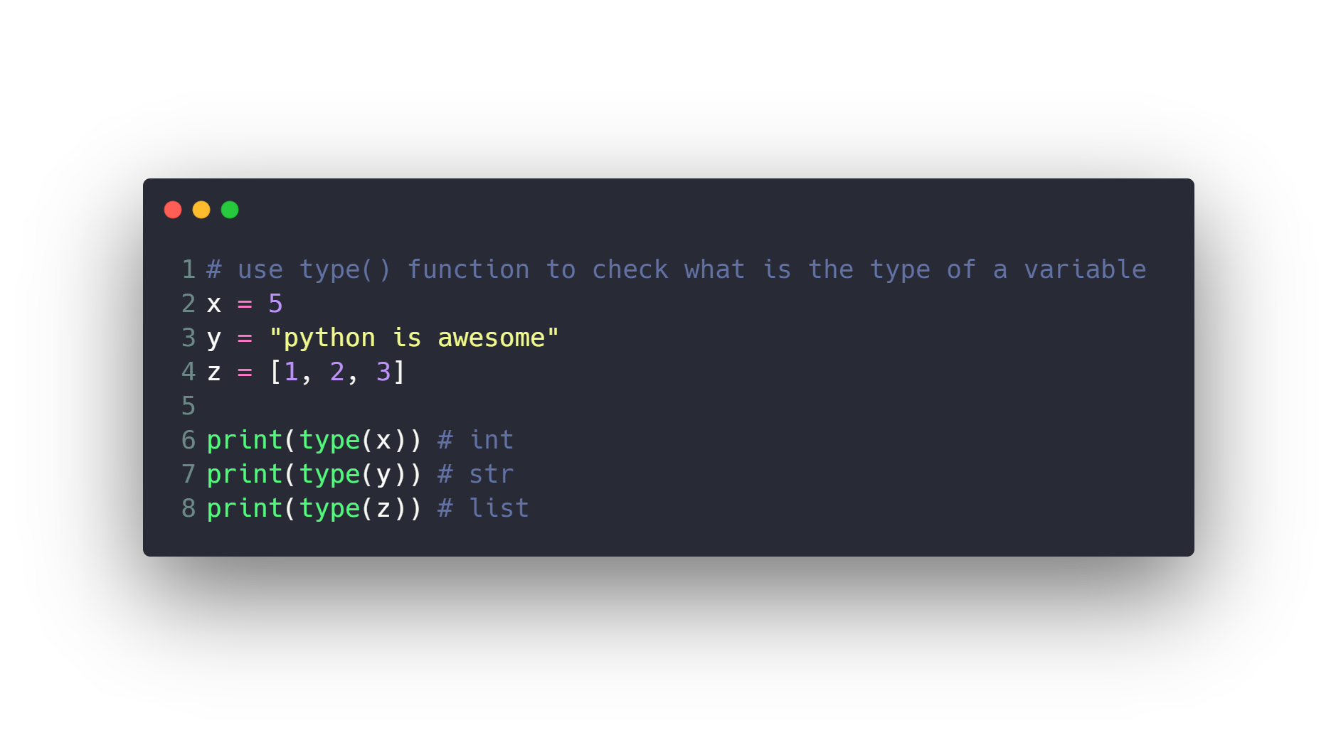
Data types

Slide 15
Introduction to Python programming Course Outline
Intro to Computer Science
Environment Setup (Anaconda)
Command Line
Conda & pip package managers
Jupyter Notebook
Input & Output
Variables
Data types
Numbers & Math
Boolean & Comparison and Logic
Strings
Lists
Tuples
Sets
Dictionaries
File Handling
If Conditions
For Loops
Built-in functions & Operators (zip, enumerate, range, …)
List Comprehensions
Functions
Lambda Expressions
Map, Filter, Reduce
Variables Scope
Modules & Packages

Slide 16
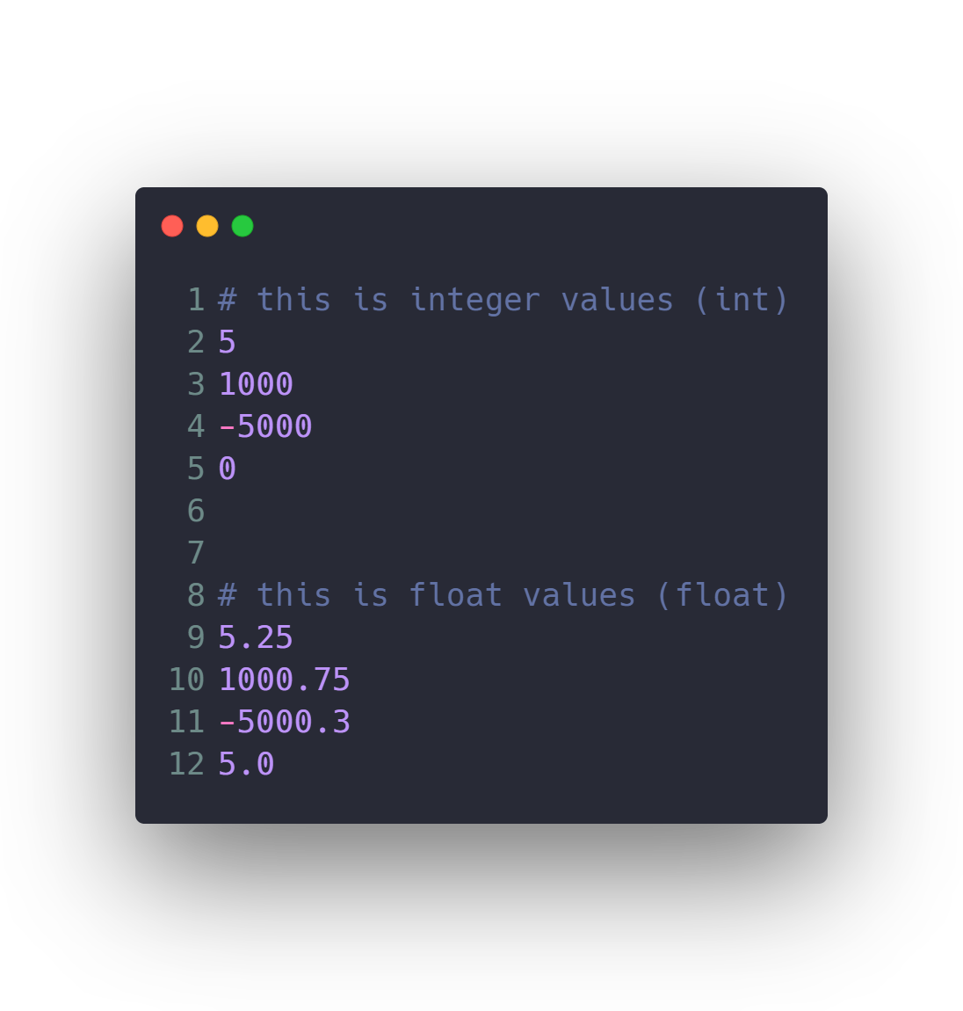
Numbers & Math

Slide 17
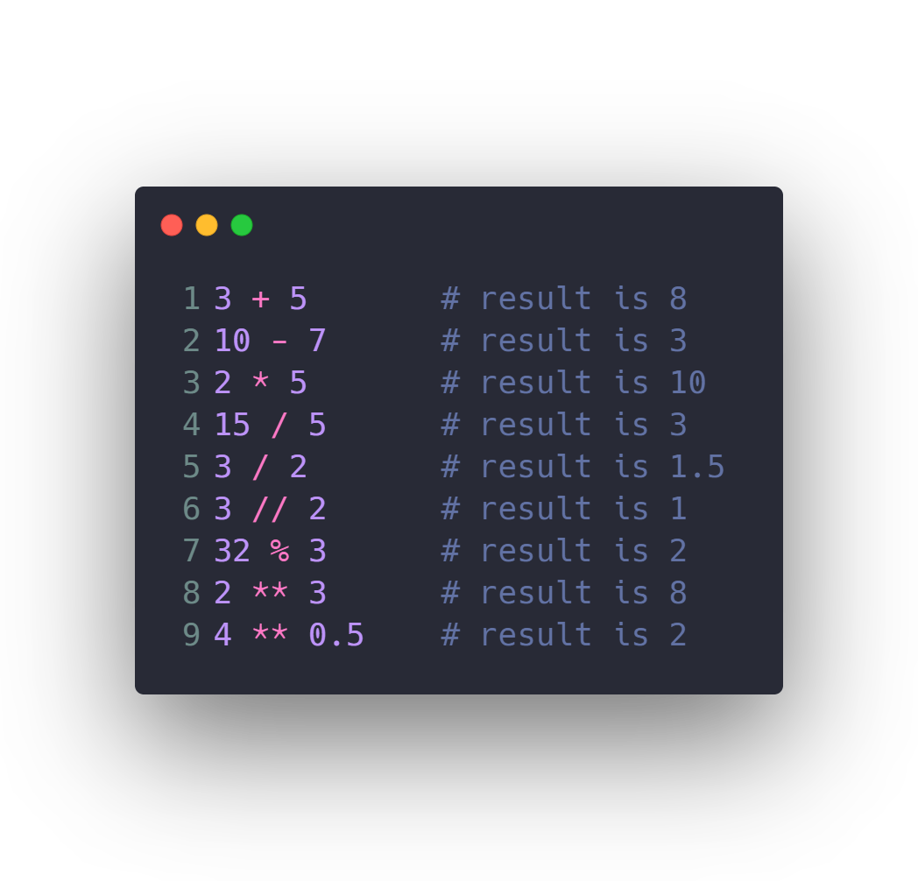
Numbers & Math

Slide 18
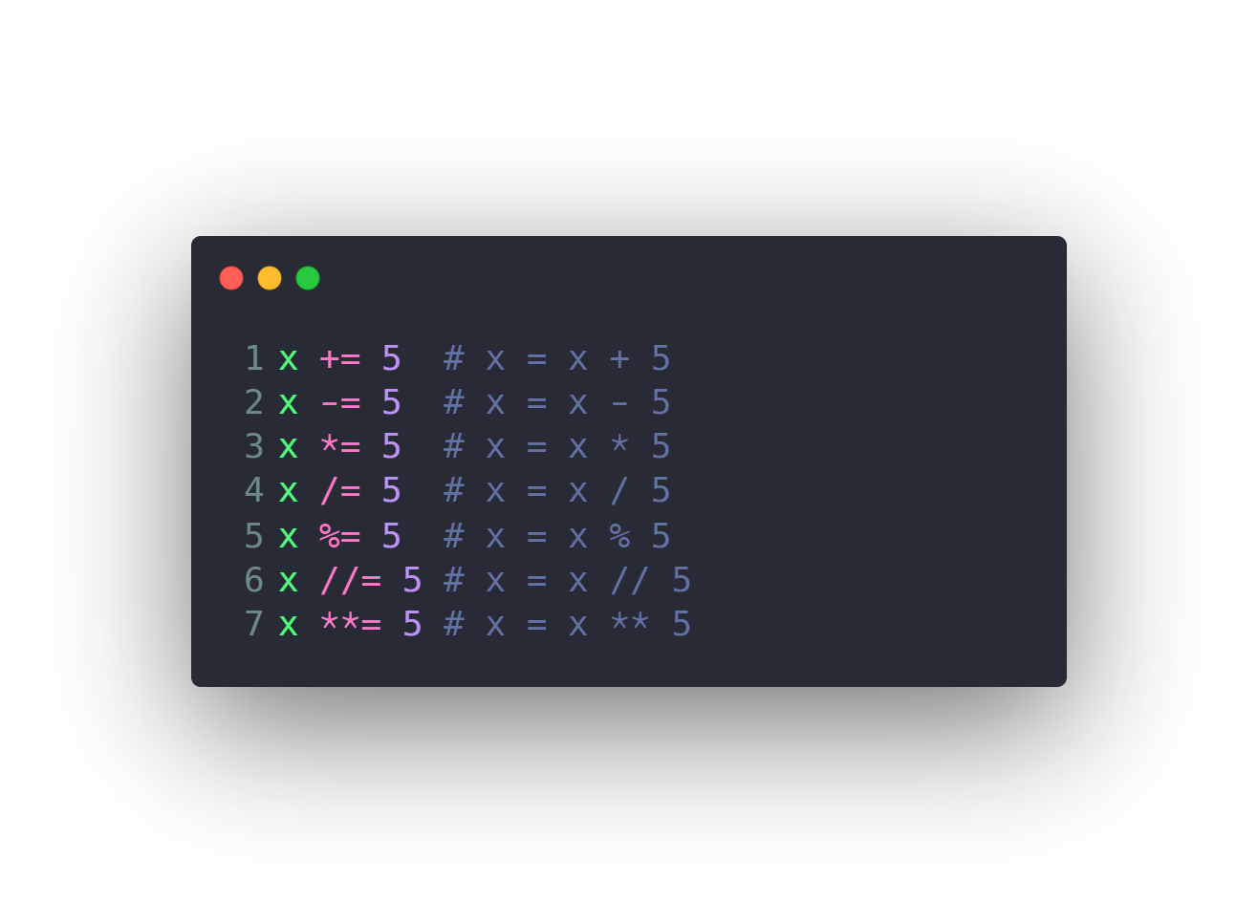
Numbers & Math

Slide 19
Introduction to Python programming Course Outline
Intro to Computer Science
Environment Setup (Anaconda)
Command Line
Conda & pip package managers
Jupyter Notebook
Input & Output
Variables
Data types
Numbers & Math
Boolean & Comparison and Logic
Strings
Lists
Tuples
Sets
Dictionaries
File Handling
If Conditions
For Loops
Built-in functions & Operators (zip, enumerate, range, …)
List Comprehensions
Functions
Lambda Expressions
Map, Filter, Reduce
Variables Scope
Modules & Packages

Slide 20
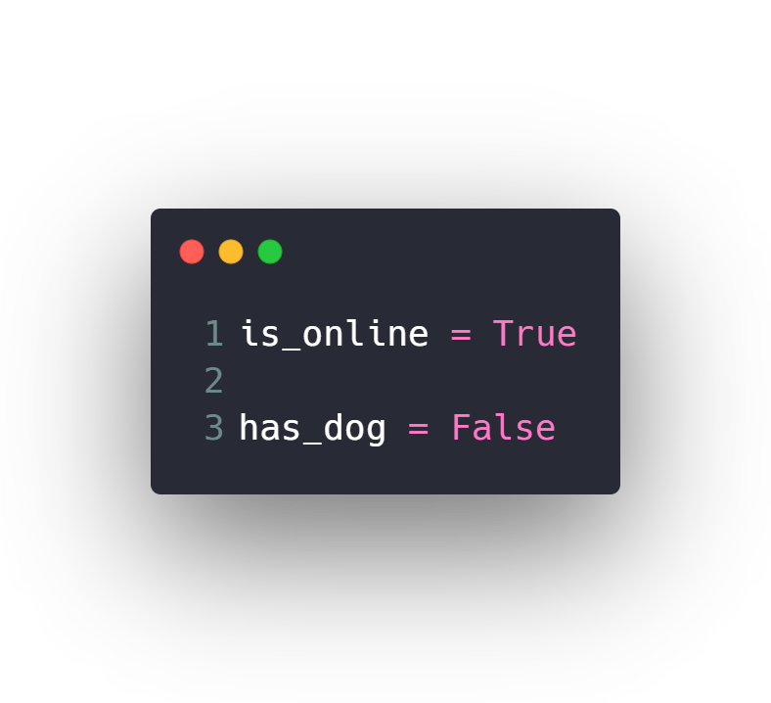
Boolean & Comparison and Logic

Slide 21
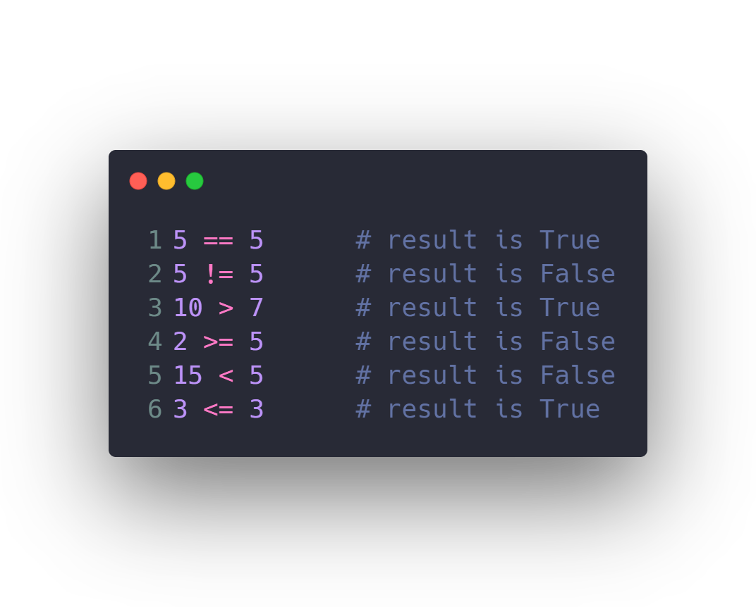
Boolean & Comparison and Logic

Slide 22
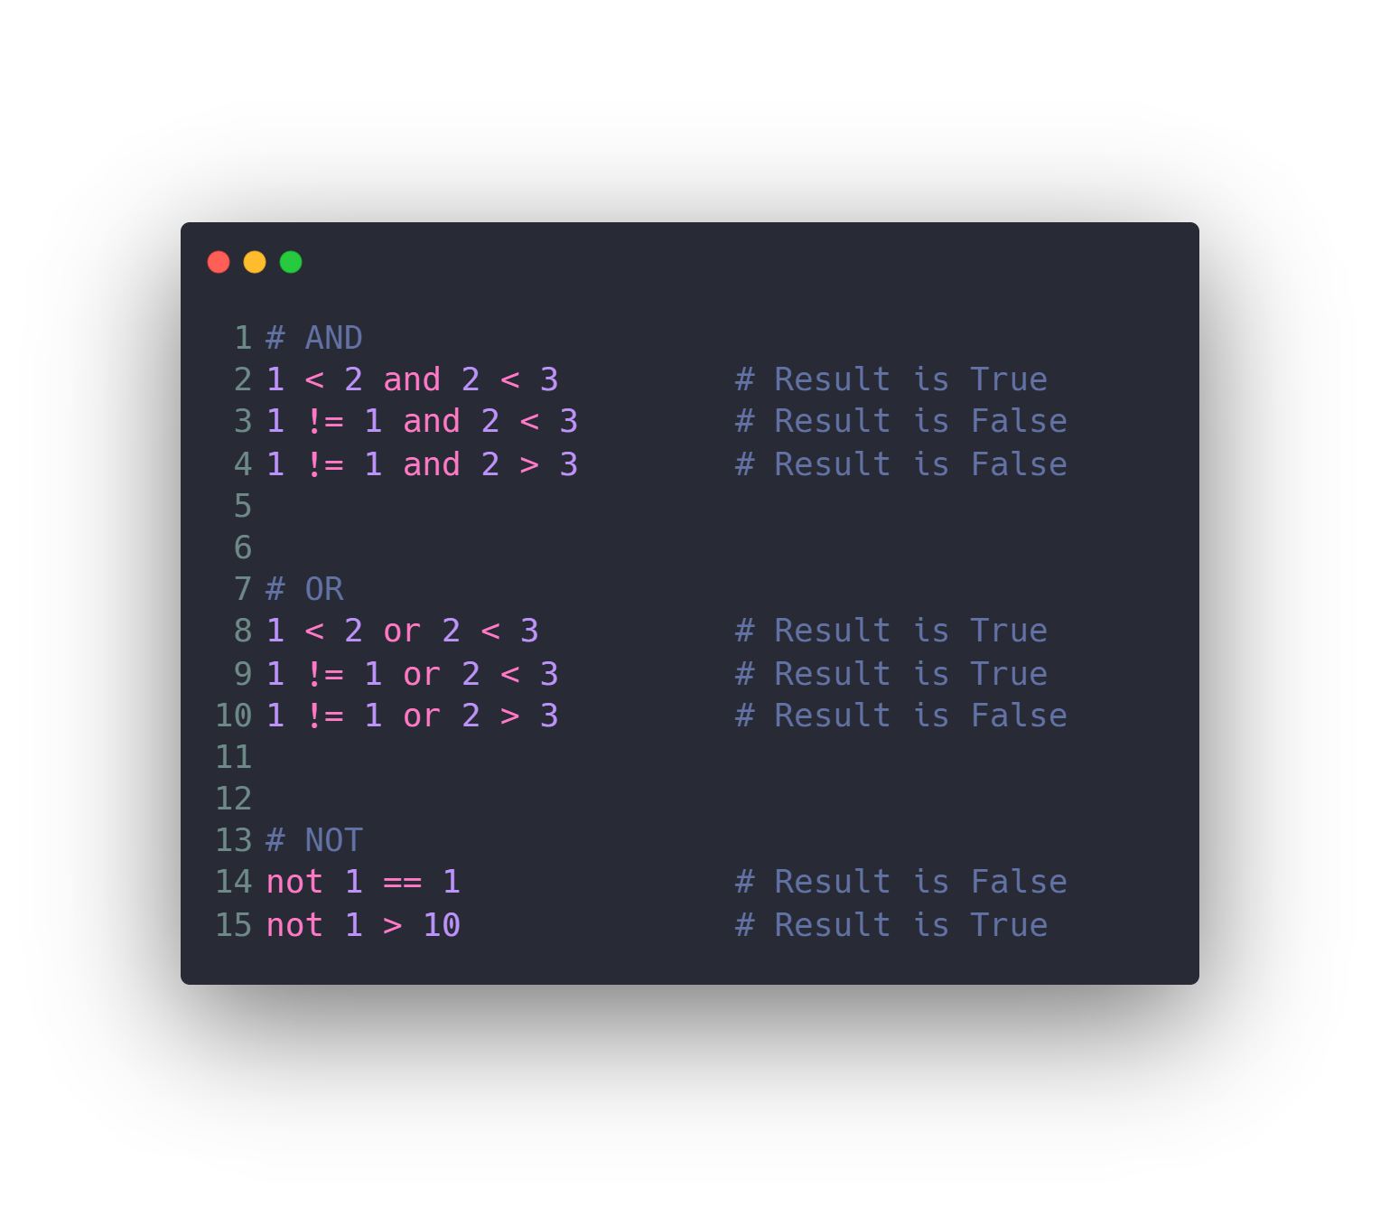
Boolean & Comparison and Logic

Slide 23
Introduction to Python programming Course Outline
Intro to Computer Science
Environment Setup (Anaconda)
Command Line
Conda & pip package managers
Jupyter Notebook
Input & Output
Variables
Data types
Numbers & Math
Boolean & Comparison and Logic
Strings
Lists
Tuples
Sets
Dictionaries
File Handling
If Conditions
For Loops
Built-in functions & Operators (zip, enumerate, range, …)
List Comprehensions
Functions
Lambda Expressions
Map, Filter, Reduce
Variables Scope
Modules & Packages

Slide 24
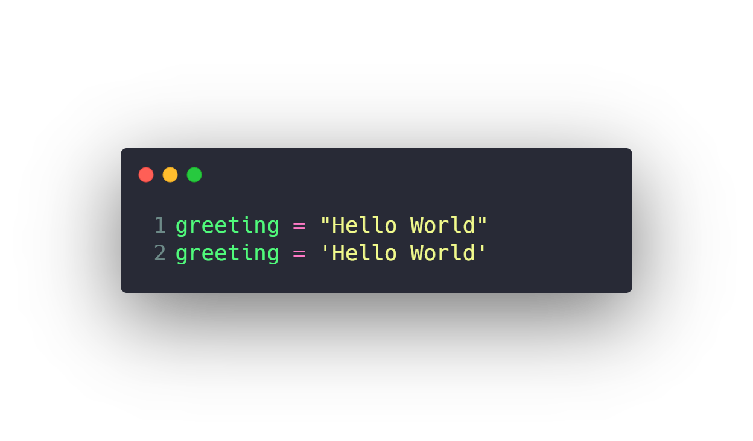
Strings

Slide 25
Introduction to Python programming Course Outline
Intro to Computer Science
Environment Setup (Anaconda)
Command Line
Conda & pip package managers
Jupyter Notebook
Input & Output
Variables
Data types
Numbers & Math
Boolean & Comparison and Logic
Strings
Lists
Tuples
Sets
Dictionaries
File Handling
If Conditions
For Loops
Built-in functions & Operators (zip, enumerate, range, …)
List Comprehensions
Functions
Lambda Expressions
Map, Filter, Reduce
Variables Scope
Modules & Packages

Slide 26
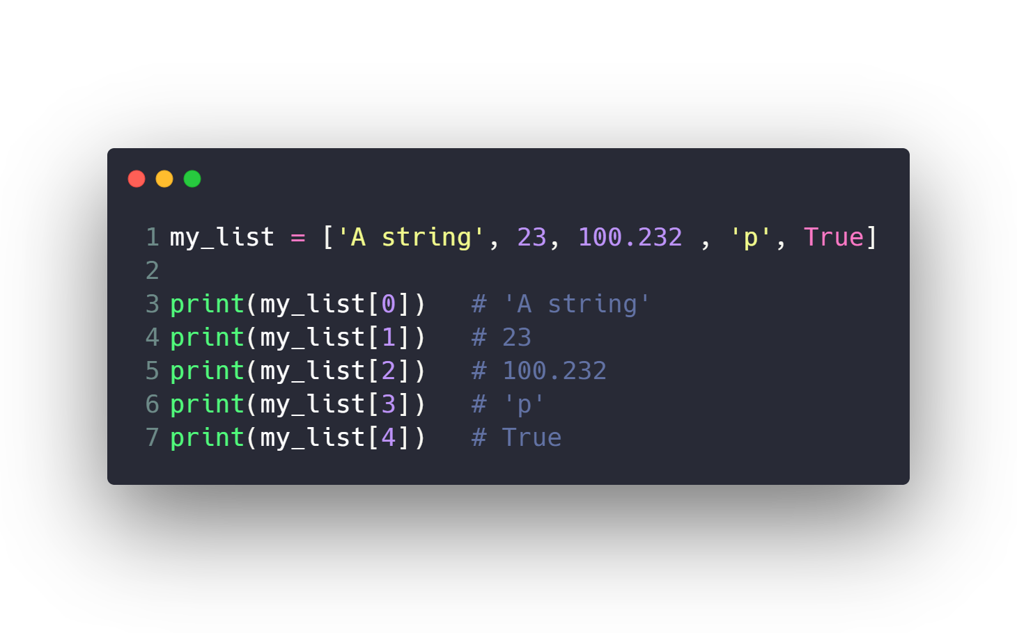
Lists

Slide 27
Introduction to Python programming Course Outline
Intro to Computer Science
Environment Setup (Anaconda)
Command Line
Conda & pip package managers
Jupyter Notebook
Input & Output
Variables
Data types
Numbers & Math
Boolean & Comparison and Logic
Strings
Lists
Tuples
Sets
Dictionaries
File Handling
If Conditions
For Loops
Built-in functions & Operators (zip, enumerate, range, …)
List Comprehensions
Functions
Lambda Expressions
Map, Filter, Reduce
Variables Scope
Modules & Packages

Slide 28
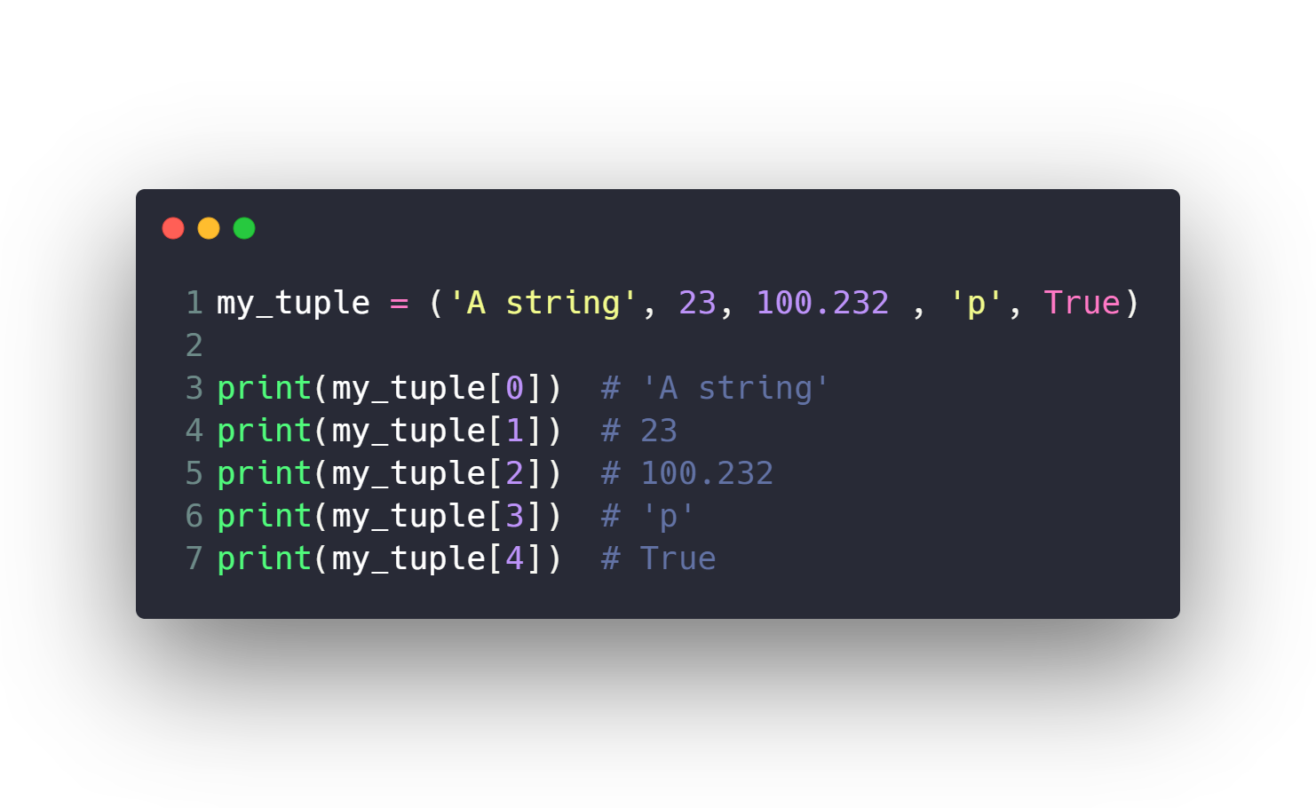
Tuples (faster and immutable lists)
Used when you have immutable values and need faster processing on them

Slide 29
Introduction to Python programming Course Outline
Intro to Computer Science
Environment Setup (Anaconda)
Command Line
Conda & pip package managers
Jupyter Notebook
Input & Output
Variables
Data types
Numbers & Math
Boolean & Comparison and Logic
Strings
Lists
Tuples
Sets
Dictionaries
File Handling
If Conditions
For Loops
Built-in functions & Operators (zip, enumerate, range, …)
List Comprehensions
Functions
Lambda Expressions
Map, Filter, Reduce
Variables Scope
Modules & Packages

Slide 30
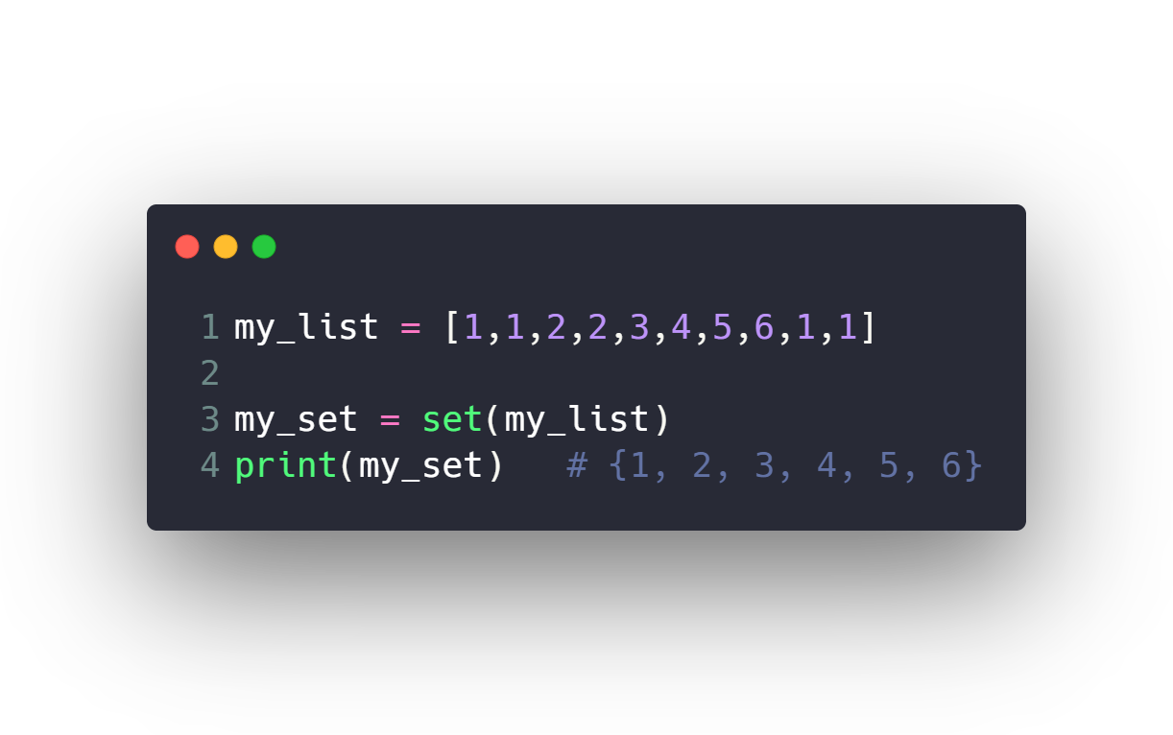
Sets (unique lists)
Used for intersections & union operations

Slide 31
Introduction to Python programming Course Outline
Intro to Computer Science
Environment Setup (Anaconda)
Command Line
Conda & pip package managers
Jupyter Notebook
Input & Output
Variables
Data types
Numbers & Math
Boolean & Comparison and Logic
Strings
Lists
Tuples
Sets
Dictionaries
File Handling
If Conditions
For Loops
Built-in functions & Operators (zip, enumerate, range, …)
List Comprehensions
Functions
Lambda Expressions
Map, Filter, Reduce
Variables Scope
Modules & Packages

Slide 32
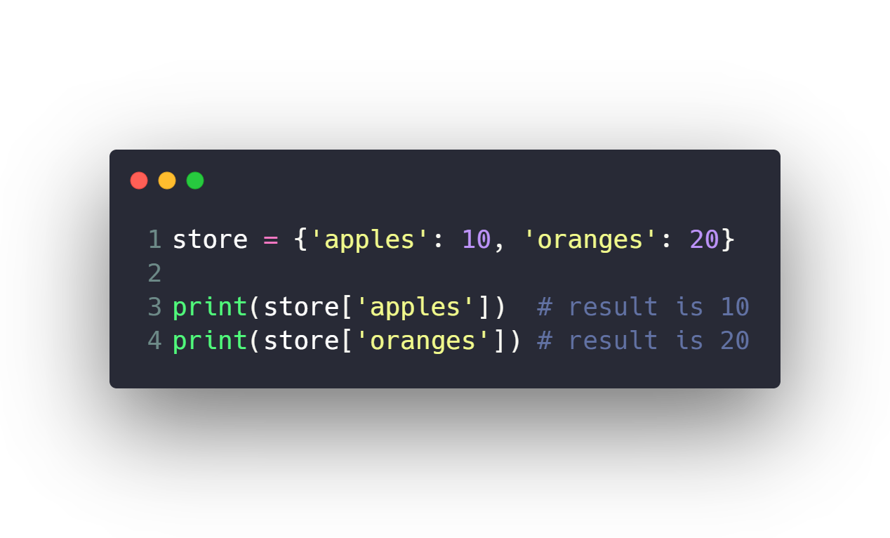
Dictionaries

Slide 33
Introduction to Python programming Course Outline
Intro to Computer Science
Environment Setup (Anaconda)
Command Line
Conda & pip package managers
Jupyter Notebook
Input & Output
Variables
Data types
Numbers & Math
Boolean & Comparison and Logic
Strings
Lists
Tuples
Sets
Dictionaries
File Handling
If Conditions
For Loops
Built-in functions & Operators (zip, enumerate, range, …)
List Comprehensions
Functions
Lambda Expressions
Map, Filter, Reduce
Variables Scope
Modules & Packages

Slide 34
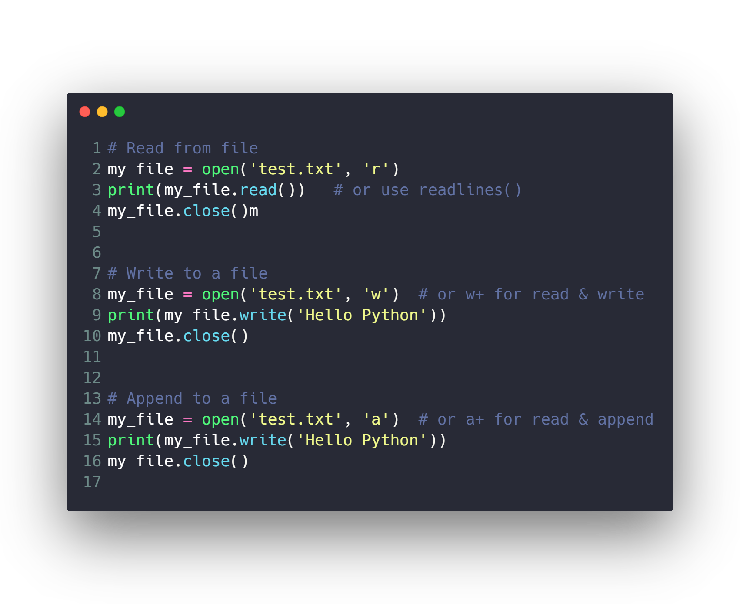
File Handling

Slide 35
Introduction to Python programming Course Outline
Intro to Computer Science
Environment Setup (Anaconda)
Command Line
Conda & pip package managers
Jupyter Notebook
Input & Output
Variables
Data types
Numbers & Math
Boolean & Comparison and Logic
Strings
Lists
Tuples
Sets
Dictionaries
File Handling
If Conditions
For Loops
Built-in functions & Operators (zip, enumerate, range, …)
List Comprehensions
Functions
Lambda Expressions
Map, Filter, Reduce
Variables Scope
Modules & Packages

Slide 36
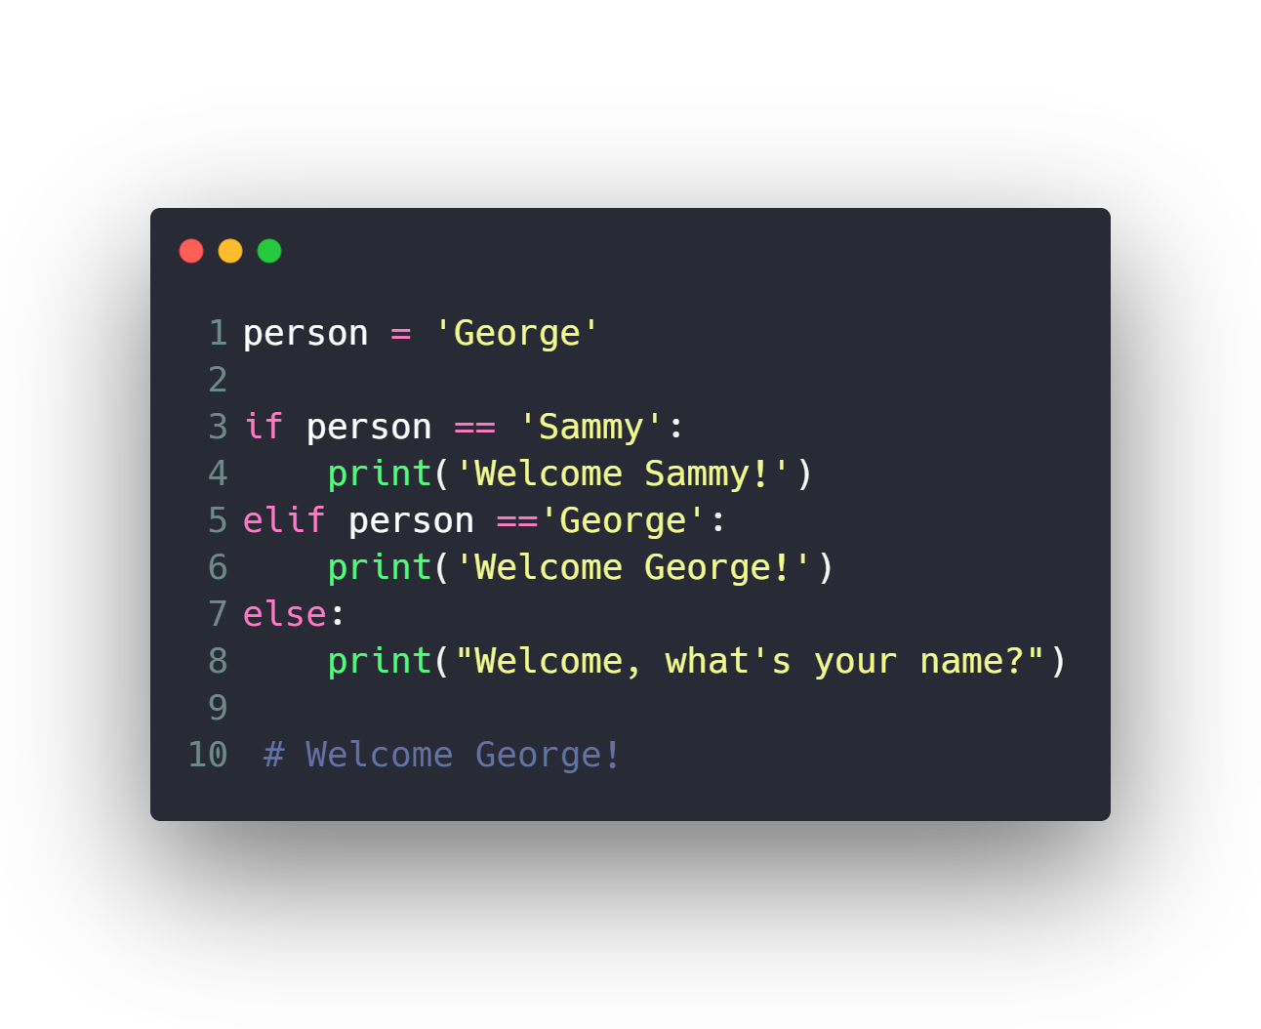
If Conditions

Slide 37
Introduction to Python programming Course Outline
Intro to Computer Science
Environment Setup (Anaconda)
Command Line
Conda & pip package managers
Jupyter Notebook
Input & Output
Variables
Data types
Numbers & Math
Boolean & Comparison and Logic
Strings
Lists
Tuples
Sets
Dictionaries
File Handling
If Conditions
For Loops
Built-in functions & Operators (zip, enumerate, range, …)
List Comprehensions
Functions
Lambda Expressions
Map, Filter, Reduce
Variables Scope
Modules & Packages

Slide 38
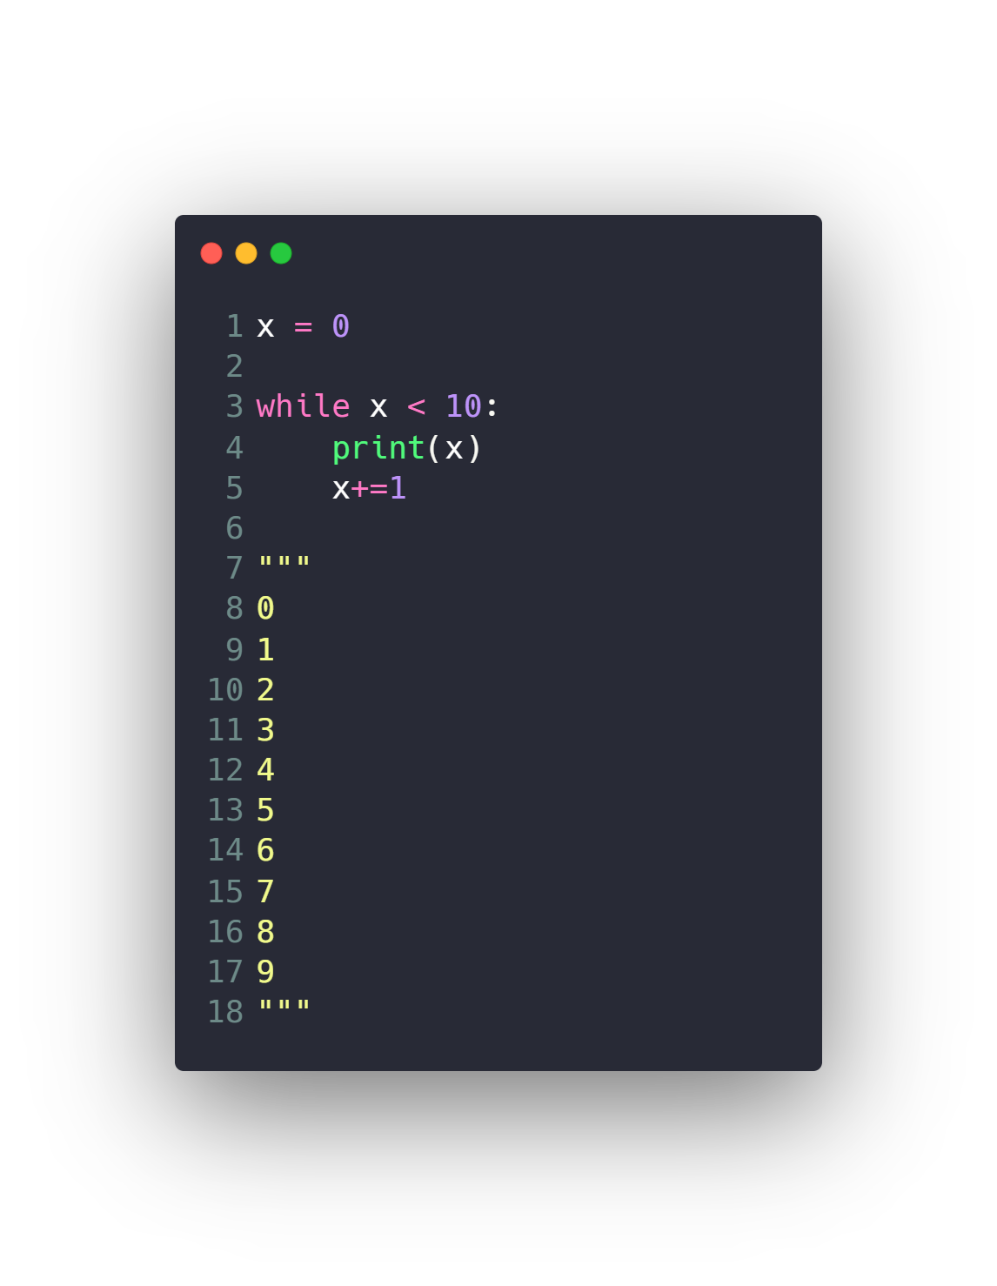
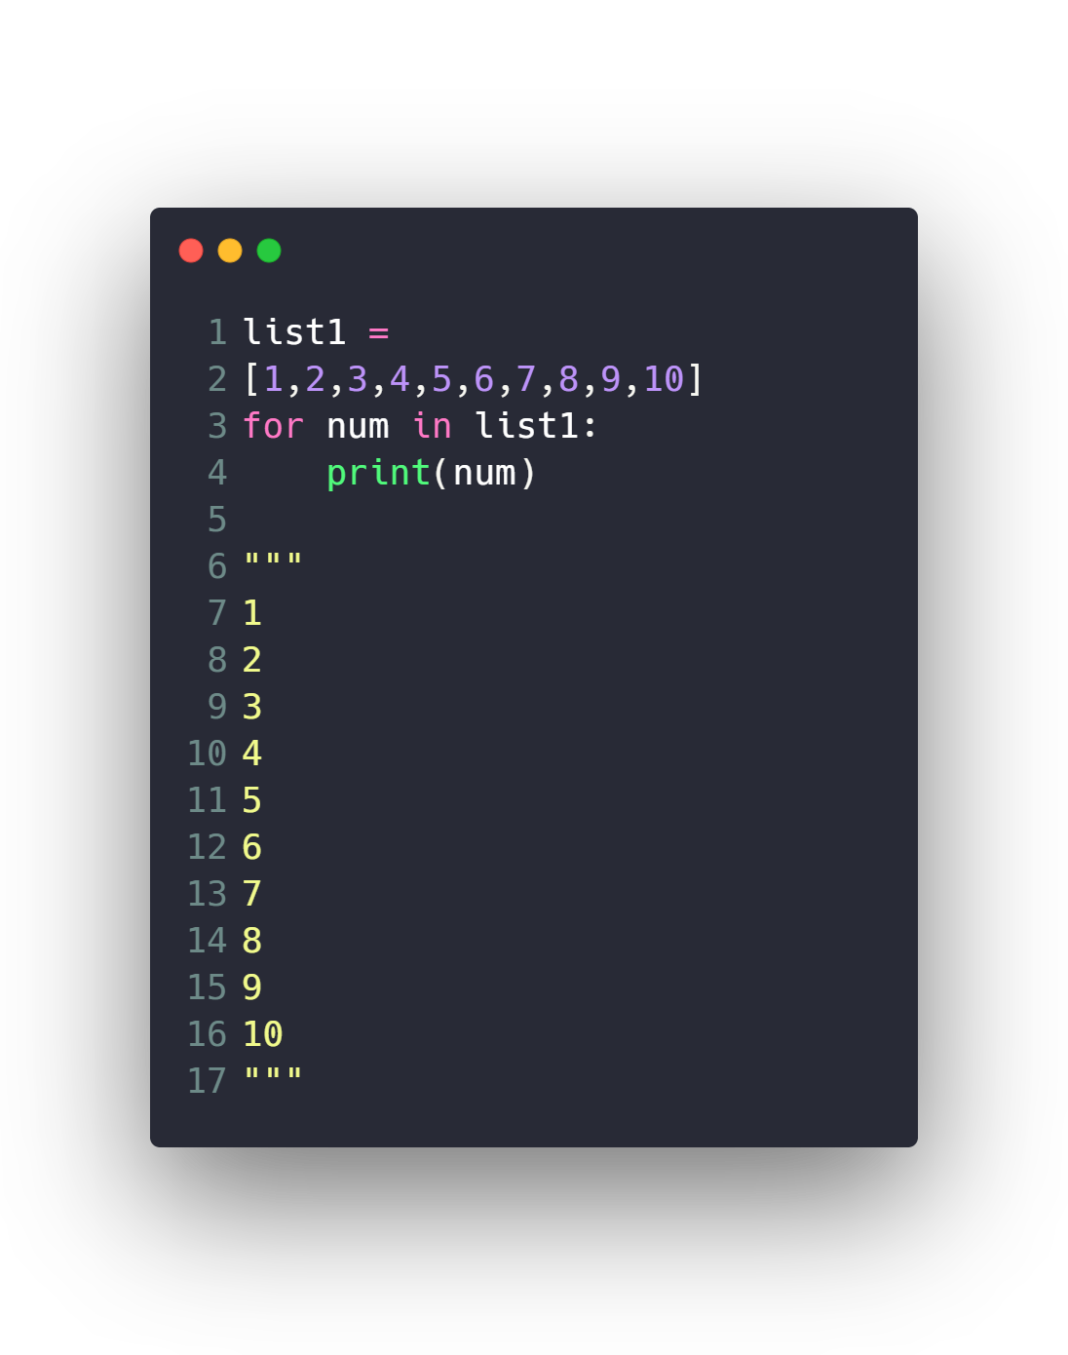
For Loops
While Loops

Slide 39
Introduction to Python programming Course Outline
Intro to Computer Science
Environment Setup (Anaconda)
Command Line
Conda & pip package managers
Jupyter Notebook
Input & Output
Variables
Data types
Numbers & Math
Boolean & Comparison and Logic
Strings
Lists
Tuples
Sets
Dictionaries
File Handling
If Conditions
For Loops
Built-in functions & Operators (zip, enumerate, range, …)
List Comprehensions
Functions
Lambda Expressions
Map, Filter, Reduce
Variables Scope
Modules & Packages

Slide 40
Built-in functions & Operators
Range
Enumerate
Zip
In
Sorted
Min & max
…

Slide 41
Introduction to Python programming Course Outline
Intro to Computer Science
Environment Setup (Anaconda)
Command Line
Conda & pip package managers
Jupyter Notebook
Input & Output
Variables
Data types
Numbers & Math
Boolean & Comparison and Logic
Strings
Lists
Tuples
Sets
Dictionaries
File Handling
If Conditions
For Loops
Built-in functions & Operators (zip, enumerate, range, …)
List Comprehensions
Functions
Lambda Expressions
Map, Filter, Reduce
Variables Scope
Modules & Packages

Slide 42
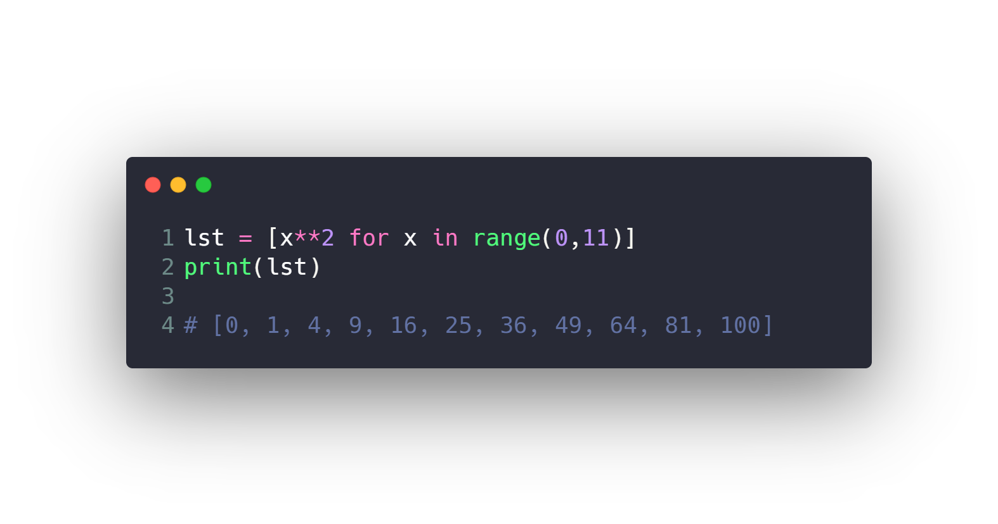
List Comprehensions

Slide 43
Introduction to Python programming Course Outline
Intro to Computer Science
Environment Setup (Anaconda)
Command Line
Conda & pip package managers
Jupyter Notebook
Input & Output
Variables
Data types
Numbers & Math
Boolean & Comparison and Logic
Strings
Lists
Tuples
Sets
Dictionaries
File Handling
If Conditions
For Loops
Built-in functions & Operators (zip, enumerate, range, …)
List Comprehensions
Functions
Lambda Expressions
Map, Filter, Reduce
Variables Scope
Modules & Packages

Slide 44
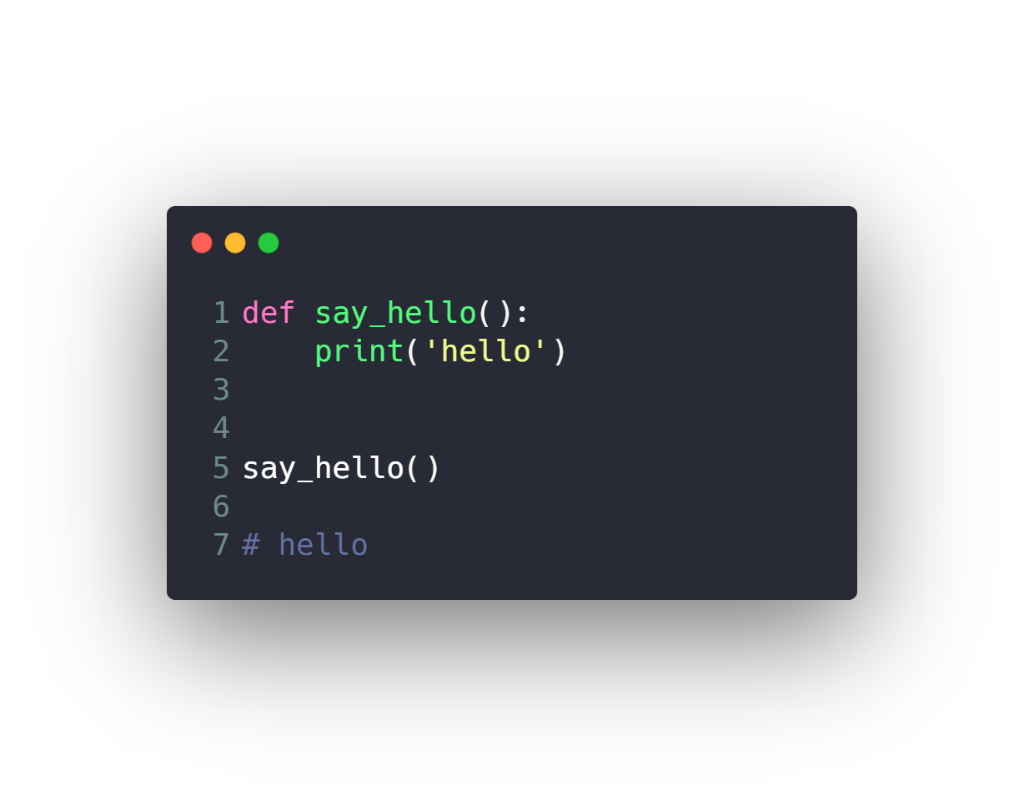
Functions

Slide 45
Introduction to Python programming Course Outline
Intro to Computer Science
Environment Setup (Anaconda)
Command Line
Conda & pip package managers
Jupyter Notebook
Input & Output
Variables
Data types
Numbers & Math
Boolean & Comparison and Logic
Strings
Lists
Tuples
Sets
Dictionaries
File Handling
If Conditions
For Loops
Built-in functions & Operators (zip, enumerate, range, …)
List Comprehensions
Functions
Lambda Expressions
Map, Filter, Reduce
Variables Scope
Modules & Packages

Slide 46
Lambda Expressions & Map, Filter, Reduce
Map
Filter
Reduce
Lambda Expression

Slide 47
Introduction to Python programming Course Outline
Intro to Computer Science
Environment Setup (Anaconda)
Command Line
Conda & pip package managers
Jupyter Notebook
Input & Output
Variables
Data types
Numbers & Math
Boolean & Comparison and Logic
Strings
Lists
Tuples
Sets
Dictionaries
File Handling
If Conditions
For Loops
Built-in functions & Operators (zip, enumerate, range, …)
List Comprehensions
Functions
Lambda Expressions
Map, Filter, Reduce
Variables Scope
Modules & Packages

Slide 48
Variables Scope
Local
Global

Slide 49
Introduction to Python programming Course Outline
Intro to Computer Science
Environment Setup (Anaconda)
Command Line
Conda & pip package managers
Jupyter Notebook
Input & Output
Variables
Data types
Numbers & Math
Boolean & Comparison and Logic
Strings
Lists
Tuples
Sets
Dictionaries
File Handling
If Conditions
For Loops
Built-in functions & Operators (zip, enumerate, range, …)
List Comprehensions
Functions
Lambda Expressions
Map, Filter, Reduce
Variables Scope
Modules & Packages

Slide 50
Modules & Packages
Module is a file which contains various Python functions and global variables. It is simply just .py extension file which has python executable code.
Package is a collection of modules.
Library is a collection of packages.
Framework is a collection of libraries.

Slide 51
Modules & Packages
Random
OS
Datetime
How to make your custom module
How to make your custom package

Slide 52
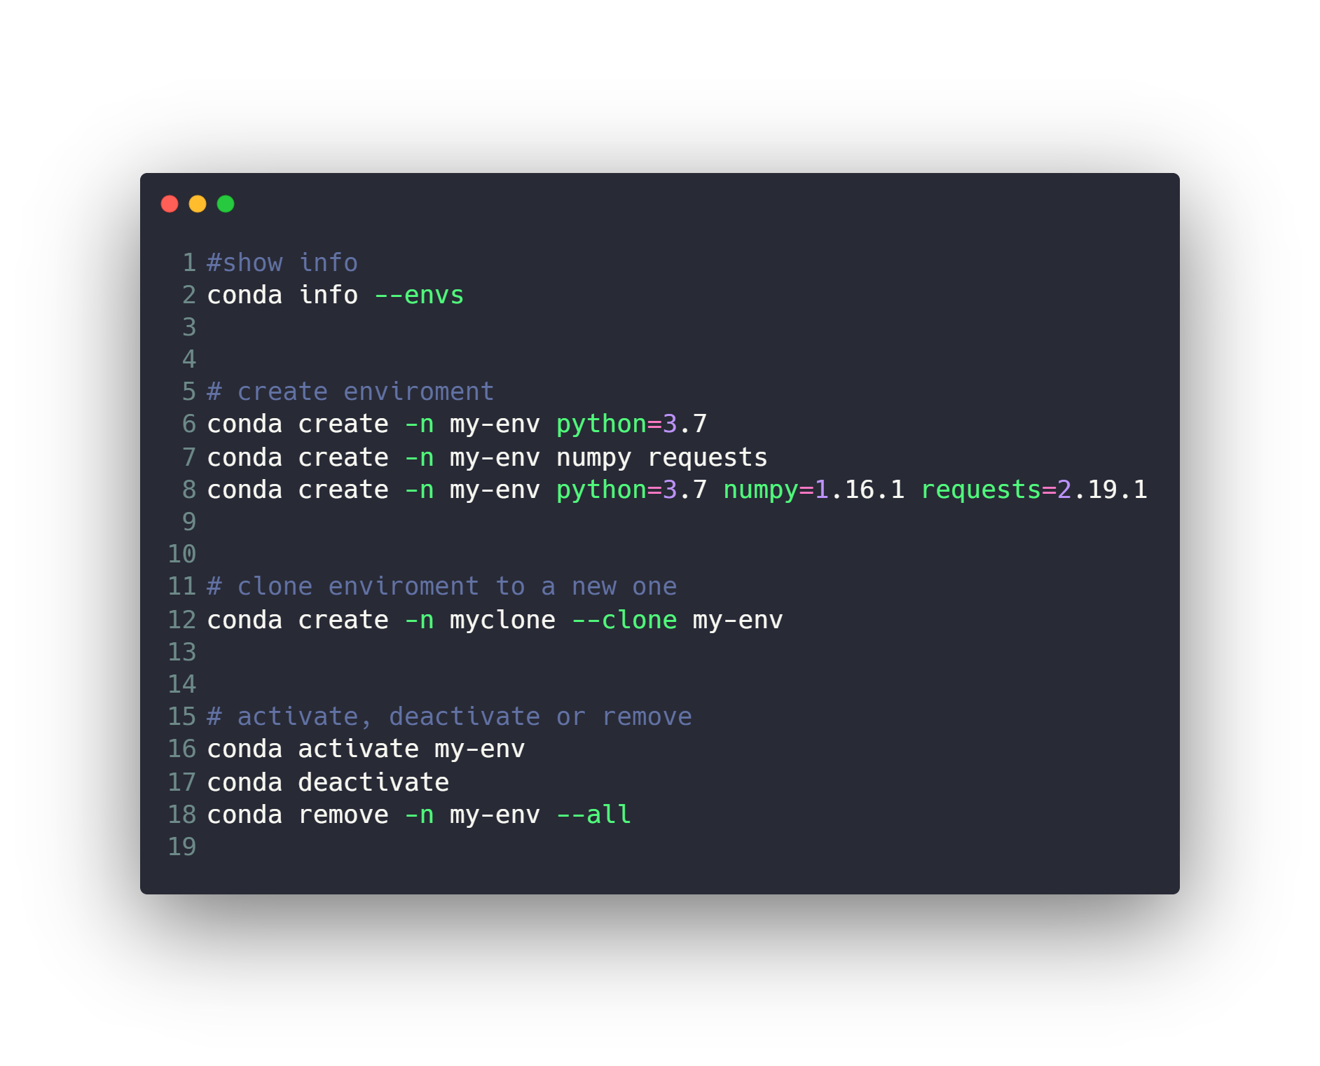
Conda enviroments
Don’t forget to add jupyter kernel for this newly created enviroment
https://janakiev.com/blog/jupyter-virtual-envs/

Slide 53
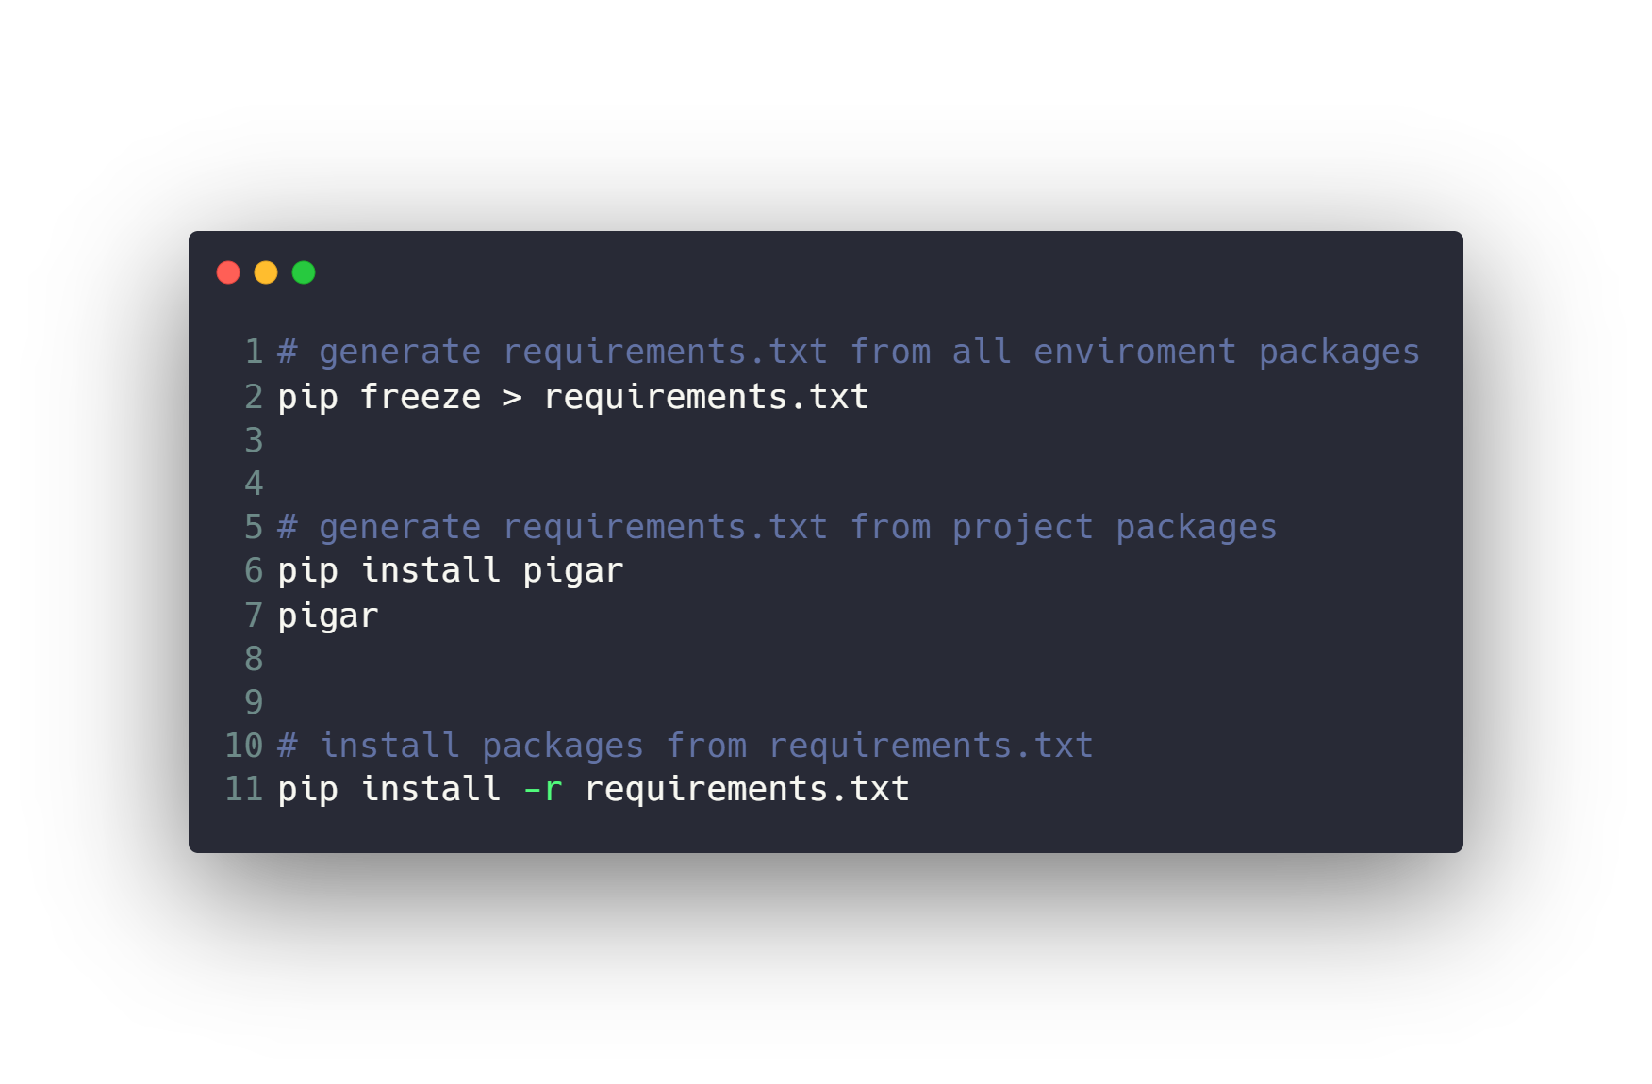
Conda enviroments

Slide 54

Time for Thanos.py >_

Slide 55
Questions ?!

Slide 56

Thanks! >_ Live long and prosper

